Slide 1

Finance and Risk Analytics
INSIGHTS
Presented By
Praveen N. Sharma

Slide 2
AGENDA
Objective
Inferences and Visualization
Methodology

Slide 3

Analyse a portfolio of stocks to provide consultation on investment management based on client’s requirement. My task is to provide consultation to two different investors, Mr Patrick Jyenger and Mr Peter Jyenger based on their requirements and financial objectives.
Mr Patrick Jyenger wants to invest $500K in equities, he has been conservative investor during his all life and expects doubling his capital with less risk in 5 years time.
Mr Peter Jyenger wants to invest $1 million in equities, he has been high risk investor during his all life, prefers high return investment and expects doubling his capital with high risk in 5 years time.
OBJECTIVE

Slide 4

Inferences
and Visualization

Slide 5
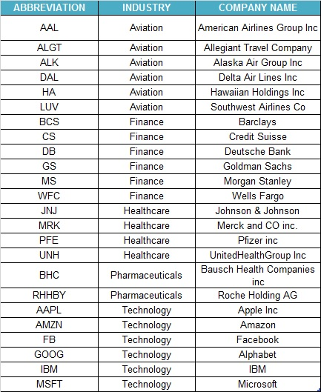
STOCKS DATA AVAILABLE
There are 24 stocks available from four sectors containing 6 stocks from each sector.
There is an index available to compare the stocks outcome with. S&P500 is a combinations of top 500 stocks in US stock market.
This is the list of stocks with there abbreviation and Industry and company name.

Slide 6
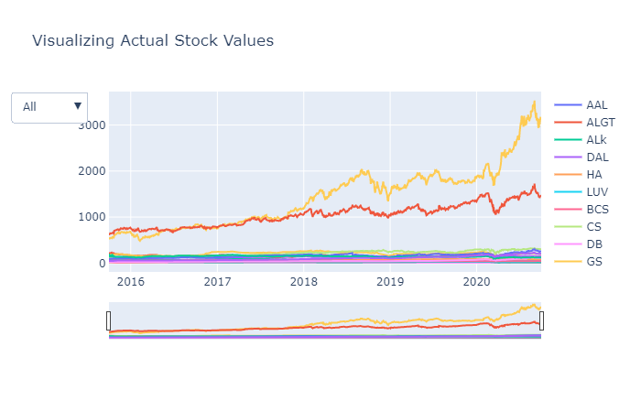
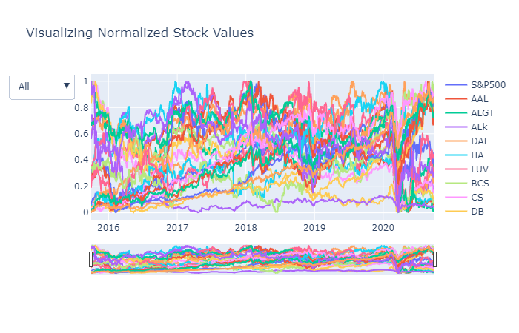
Visualization of Actual stock Values
Visualizing Normalized Stock Values
The above graph shows how all stocks have performed over the last 5 years. The graph clearly shows that Amazon and Google are best performing over the last 5 years as comparison with other stocks.
Above graph shows that how all the stocks have performed when compared with S&P500 index. Here we can see that there are 8 stocks having returns of greater than 80% at the end of 5 years.

Slide 7
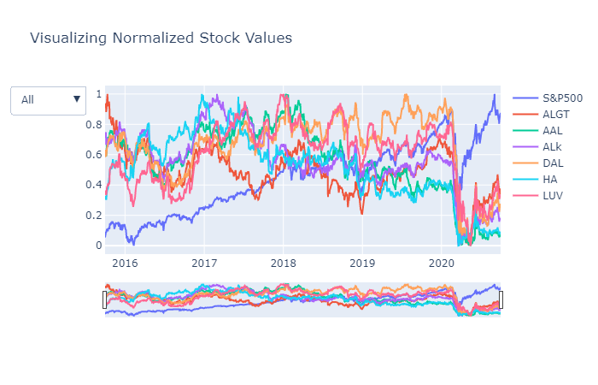

Sector Wise Analysis
Aviation Sector
The stocks were constantly making side ways but due to Corona Pandemic hit in March 2020 Aviation sector has faced a major crisis and the sector has not recovered there after even thought market index has hone up.

Slide 8
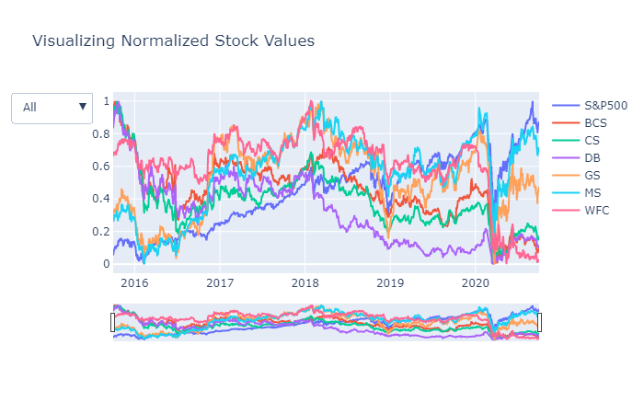
Finance Sector
Due to Corona Pandemic hit in March 2020 Finance sector has also faced a major crisis and the sector has recovered a bit although majority of stocks has been hit.
Morgan Stanley & Goldman Sachs have performed well when compared to other stocks.

Slide 9
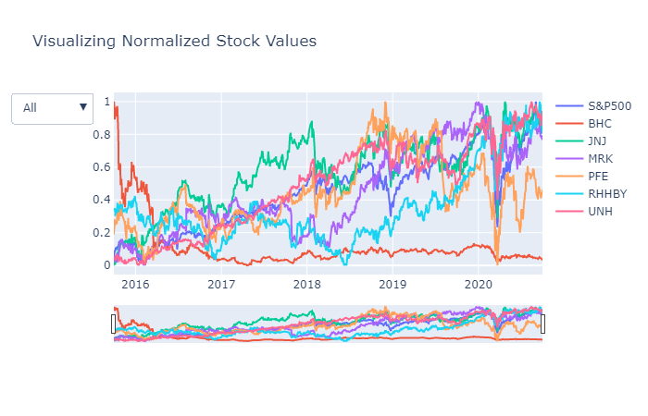
Pharma and Healthcare Sector
Due to Corona Pandemic hit in March 2020 Pharma & Health care sector has also faced a major crisis and the recovery rate shown by this sector is commendable.
United Health, Johnson & Johnson have performed well when compared to S&P Index.
Bausch Health is consistently performed very badly over the years when compared to other stocks in the same sector.

Slide 10
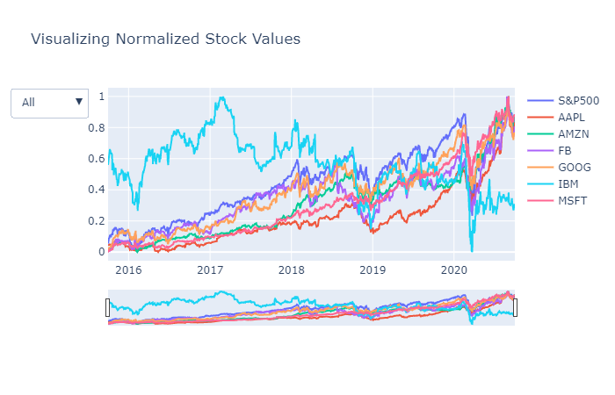
Technology Sector
Due to Covid Pandemic hit in March 2020 Technology Sector has also faced crisis but the recovery rate shown by this sector is commendable.
Microsoft, Amazon, Apple, Facebook & Google have performed well along with Market index.
The stock performed very badly over the years when compared to other stocks in the same sector is IBM

Slide 11
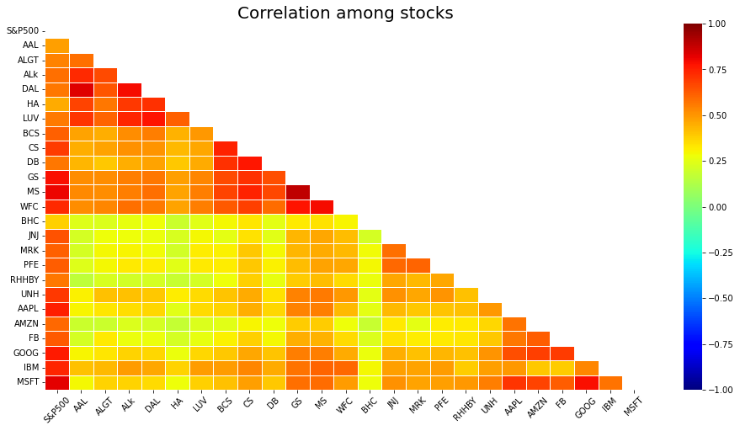
Correlation Among Stocks
Microsoft & Google stocks are highly correlated in the Technology sector Stocks.
Goldman Sachs, Morgan Stanley & Wells Fargo are correlated in the Finance sector Stocks.
American Airlines & Delta Airlines are more correlated than Alaska Air Group in the Aviation sector stocks.
Pharma sector stocks are less correlated when compared to any other sector stocks.

Slide 12
At the end of 5 years we can see that top 8 stocks having returns greater than 80% are as follows:
Stocks | Avg Daily Returns | Risk | Min | Max | Annualized_Returns | Annualized_Risk | Sharpe_Ratio | Cumulative Returns
AMZN | 0.16 | 1.90 | -7.92 | 13.22 | 40.59 | 30.11 | 1.32 | 504.69
MSFT | 0.14 | 1.75 | -14.74 | 14.22 | 34.95 | 27.84 | 1.23 | 371.49
AAPL | 0.13 | 1.87 | -12.86 | 11.98 | 33.32 | 29.73 | 1.10 | 322.74
FB | 0.10 | 2.04 | -18.96 | 15.52 | 26.45 | 32.31 | 0.80 | 187.96
UNH | 0.09 | 1.78 | -17.28 | 12.80 | 23.72 | 28.27 | 0.81 | 167.36
GOOG | 0.08 | 1.65 | -11.10 | 10.45 | 21.02 | 26.23 | 0.77 | 140.41
MS | 0.06 | 2.18 | -15.60 | 19.77 | 14.55 | 34.62 | 0.40 | 53.49
S&P500 | 0.05 | 1.21 | -11.98 | 9.38 | 13.04 | 19.18 | 0.64 | 74.81
MRK | 0.05 | 1.41 | -8.90 | 10.41 | 12.88 | 22.33 | 0.54 | 68.02
JNJ | 0.05 | 1.25 | -10.04 | 8.00 | 11.35 | 19.78 | 0.54 | 59.79
GS | 0.03 | 1.99 | -12.71 | 17.58 | 7.64 | 31.59 | 0.22 | 14.17
RHHBY | 0.03 | 1.35 | -8.96 | 13.01 | 7.38 | 21.45 | 0.31 | 28.87
LUV | 0.02 | 2.29 | -15.11 | 14.44 | 6.16 | 36.37 | 0.15 | -2.37
PFE | 0.02 | 1.38 | -7.73 | 8.96 | 5.25 | 21.95 | 0.21 | 15.26
DAL | 0.00 | 2.65 | -25.99 | 21.02 | 1.05 | 42.03 | 0.01 | -32.66
HA | 0.00 | 3.31 | -26.50 | 24.58 | 0.86 | 52.60 | 0.00 | -47.88
IBM | -0.00 | 1.61 | -12.85 | 11.30 | -0.04 | 25.54 | -0.03 | -15.27
ALGT | -0.00 | 2.91 | -28.33 | 29.24 | -1.19 | 46.20 | -0.04 | -45.04
ALk | -0.03 | 2.69 | -23.24 | 20.31 | -6.44 | 42.71 | -0.17 | -54.34
AAL | -0.03 | 3.47 | -25.22 | 41.10 | -8.47 | 55.12 | -0.17 | -68.65
WFC | -0.04 | 2.03 | -15.87 | 14.53 | -10.44 | 32.30 | -0.35 | -54.30
CS | -0.04 | 2.28 | -18.26 | 16.34 | -11.01 | 36.26 | -0.32 | -58.61
DB | -0.05 | 2.77 | -17.49 | 14.02 | -13.33 | 44.04 | -0.32 | -68.33
BCS | -0.05 | 2.51 | -21.85 | 15.10 | -13.82 | 39.87 | -0.37 | -66.62
BHC | -0.09 | 4.46 | -51.46 | 33.74 | -22.60 | 70.72 | -0.33 | -91.35
AMZN gives 40.59% annual returns.
MSFT gives 34.95% annual returns.
AAPL gives 33.32% annual returns.
FB gives 26.45% annual returns.
UNH gives 23.72% annual returns.
GOOG gives 21.02% annual returns.
MS gives 14.55% annual returns.
S&P500 gives 13.04% annual returns.

Slide 13


Methodology

Slide 14
EXPLORATORY DATA ANALYSIS:
Checked the Null values in the dataset. It was found that no columns have null values .
Checked for the outliers in the dataset.
DATA ANALYSIS:
Analysed the stock data using different calculation like daily returns, cumulative daily return, Sharpe ratio, Portfolio risk and Return on investment(ROI).
Found best suitable stocks for all portfolios.
INFERENCES AFTER ANALYSING THE DATA:
As we found out that there are 8 stocks which gives more than 80% in last five years of stock market.
The stocks that gives best return among all stocks are AMZN, MSFT, AAPL, FB, UNH, GOOG, MS, S&P500.
Each stock has different risk and liability according to its Annualized risk, Sharpe ratio.
We found out that AMZN gives highest return among all stock but has high risk as compared to other stocks.
We also found that stocks like JNJ, RHHBY, MRK and MSFT have good returns with less risk.
So after doing all the analysis we have finalized the portfolio for both the customers.

Slide 15
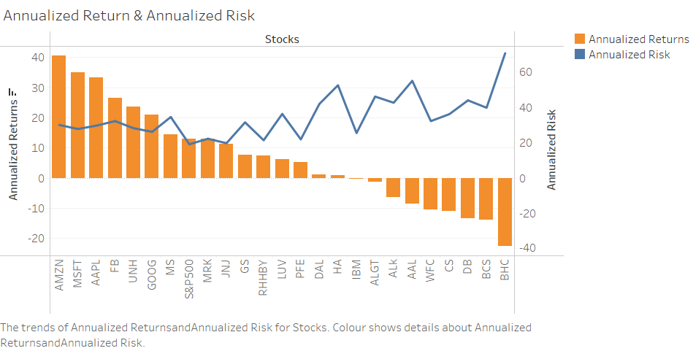
Annualized Return & Annualized Risk
Annualized Return of top five stocks are AMZN, MSFT, AAPL, FB, UNH.
All top 5 stocks have annualized return of more than 20.
The risk of these five stock is at medium level as comparison with other stocks.
The lesser the return the more chances of losing the money and debiting the initial investment.
The risk is higher for BHC, BCS, DB, CS, WFC as they did not even give return on investment as it was at the time of investing.
The lesser the ROI the higher the risk in the stocks, instead there are those stocks who does not provide best return but at least give risk free investment opportunity.
The stocks with less risk and good return are JNJ, RHHBY, MRK.

Slide 16
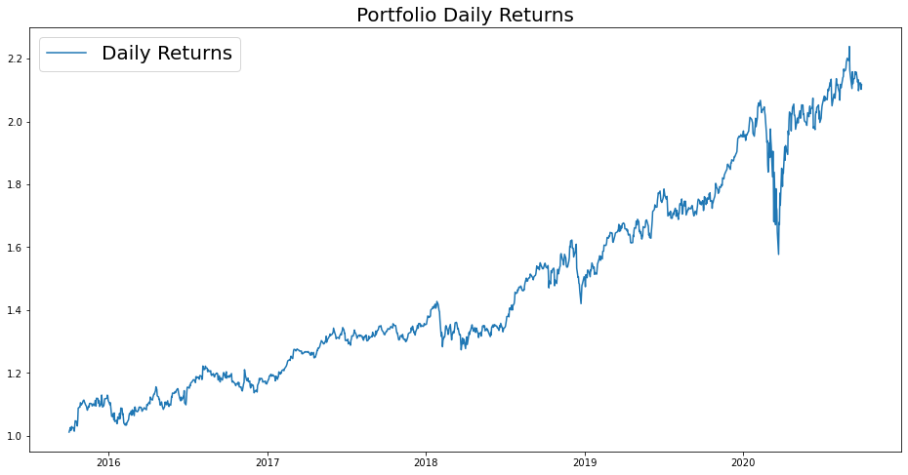
Portfolio Analysis
Patrick Jyengar Portfolio
Mr. Patrick Jyengar wants to double his investment in the span on 5 years. He wants to invest in low risk stocks which would fetch him decent returns.
As per his profile Low risk stocks like JNJ,RHHBY and MRK is suitable to invest on. But overall returns with these three stocks wouldn't reach the target what Mr. Patrick is investing for. So one portion of his wealth can be invested on MSFT to gain the desired returns.
Keeping all the weightage of stocks equal that is 0.25 across all stocks.
As Mr. Patrick jyengar invests 500 Thousand Dollar in equities i.e. the above Portfolio. Returns that he would fetch after 5 years is 1.05 Million Dollar with 558.23 Thousand dollar of gain on investment.
The majority of locations are in Manhattan.

Slide 17
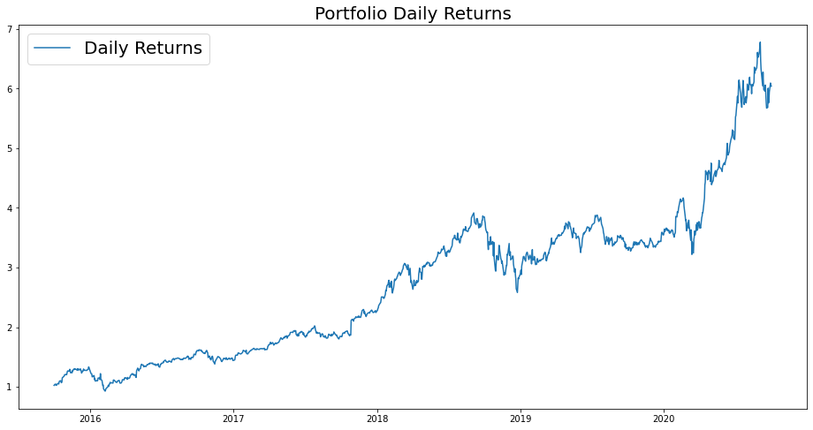
Portfolio Analysis
Peter Jyengar Portfolio
Mr. Peter Jyengar on the other hand Consistent with his attitude towards risk, he prefers high-return investments. Believes that he can still bounce back in case of any occasional losses.
He Wants to invest $1 million from company's cash and cash equivalents in the most high-margin stacks Expects high returns within 5 years for inorganic expansion of his company.
As per his profile High risk/High Returns stocks like AMZN is suitable to invest on.
Overall returns with this stock would fetch him Maximum returns and also cater the Risk. Risk associated with the above mentioned portfolio.
As Mr. Peter jyengar invests 1 Million Dollar on equities i.e. the AMZN stock. Returns that he would fetch after 5 years is more than 6 Million Dollars with 5+ Million dollars of gain on investment.
The majority of locations are in Manhattan.

Slide 18
Thank You

